Slide 1
JWT Authentication in WebAPI .netcore 6

Slide 2
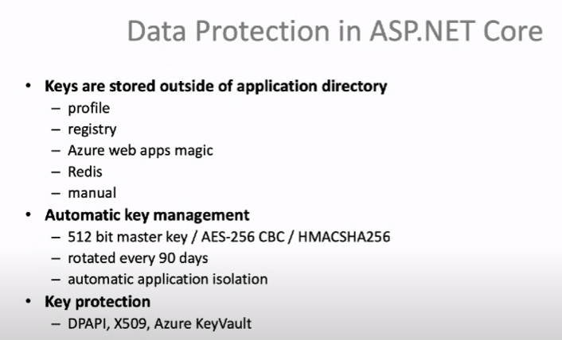

Slide 3
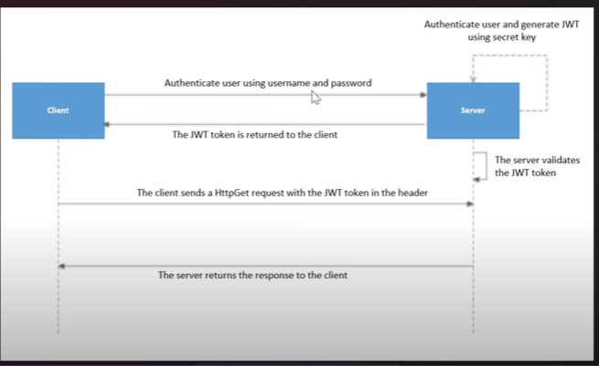

Slide 4
JSON Web Token (JWT) is a popular user authentication standard, used to securely exchange information online. This token is made up of three components – a header that specifies the algorithm used to encrypt the contents of the token; a payload that contains “claims” (information the token securely transmits); and a signature that can be used to verify the authenticity of the information.The token is mainly composed of header, payload, signature. These three parts are separated by dots(.)
Header A header in a JWT is mostly used to describe the cryptographic operations applied to the JWT like signing/decryption technique used on it. It can also contain the data about the media/content type of the information we are sending. { "typ":"JWT", "alg":"HS256" }
Payload The payload is the part of the JWT where all the user data is actually added. This data is also referred to as the ‘claims’ of the JWT. This information is readable by anyone so it is always advised to not put any confidential information in here. { "userId":"b07f85be-45da", "iss": "https://provider.domain.com/", "sub": "auth/some-hash-here", "exp": 153452683 }
Signature This is the third part of JWT and used to verify the authenticity of token. BASE64URL encoded header and payload are joined together with dot(.) and it is then hashed using the hashing algorithm defined in a header with a secret key. T

Slide 5
Example of JWT Token
header:
{ "alg" : "HS256",
"typ" : "JWT" }
Payload: { "id" : 123456789,
"name" : "Manoj"
}
Secret: DXC Technologies JSON Web Token

Slide 6
What Is JWT Authentication?
A quick refresher before we get started. A JWT is essentially a JSON-encoded representation of a claim, which may be transferred between two entities. The claim is signed digitally by the token’s issuer.
The recipient party of this token may use this digital signature to demonstrate ownership in the future.
Signed tokens can be used for authentication by verifying the genuineness of the claims they are attached to. Encrypted tokens, on the other hand, conceal those claims. When tokens are signed via private/public keys, a signature also guarantees that the party with the private key alone has signed it.

Slide 7
In which Senarios JWT used?
The following are scenarios in which JWT may be helpful:
Authentication – This is the most prevalent scenario. After the user has logged in, every following request will feature the JWT, letting the user access services, routes and resources allowed with the token. Single Sign On (SSO) commonly uses JWT today, because of its minimal overhead and its ability to be smoothly employed across various domains.
Information Exchange – JWT is one of the most effective ways of securely exchanging data between parties. For instance, a JWT may be signed using private/public key pairs to confirm the sender’s identity. Furthermore, as the signature is attained using the payload and the header, it is possible to verify that the content has not been compromised.

Slide 8
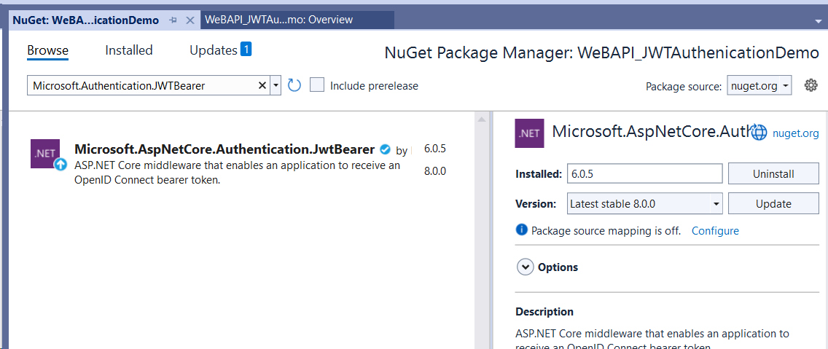
Steps
1 Create New ASpnetCore Web API 6.0 project :Uncheck https new Project
2 Add NugetPackage as follows

Slide 9
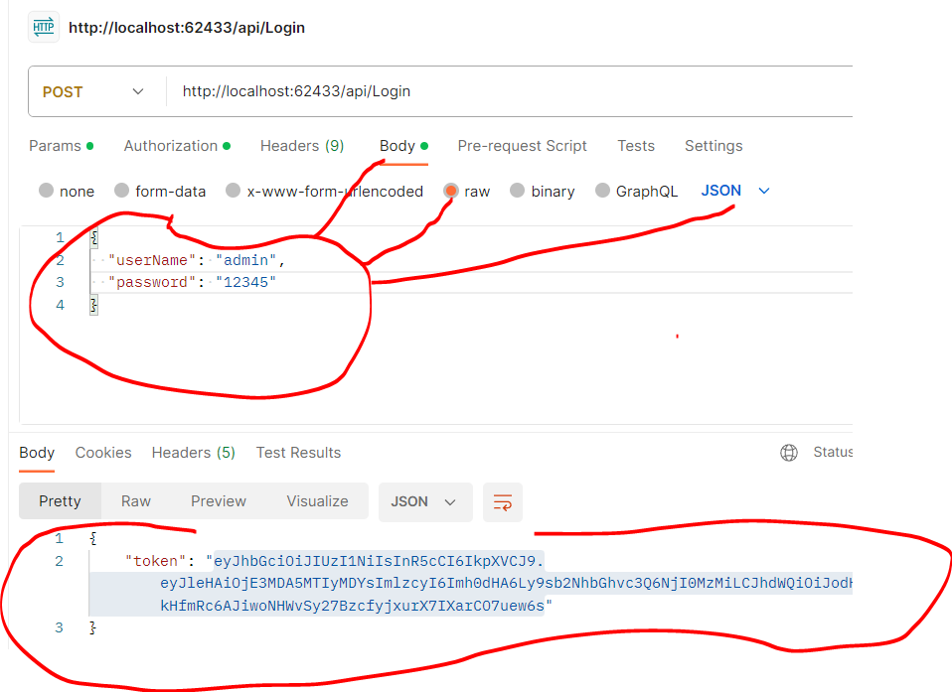
Step 1: Post method for Login Step 2: Get method for GetData

Slide 10
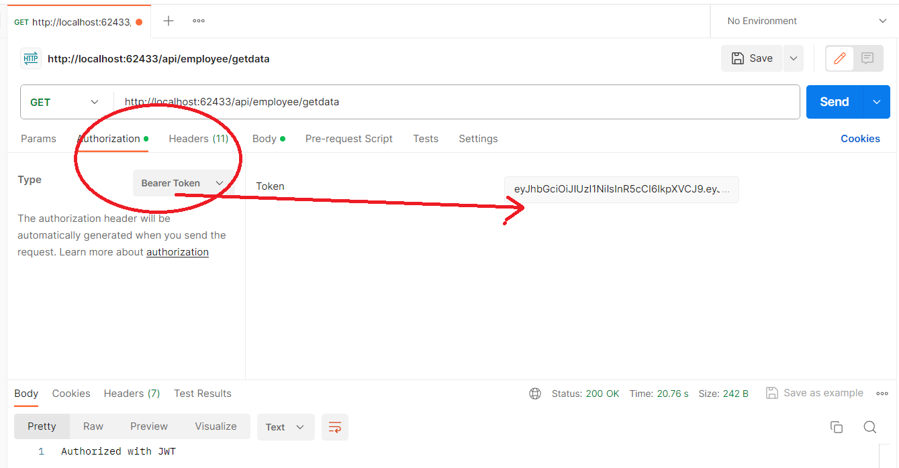

Slide 11
What is Refresh Token?
The primary purpose of a refresh token is to get long-term access to an application on behalf of a particular user. In a nutshell, a refresh token allows any website or application to re grant the access token without bothering the user. Here are its benefits: Balances security with usability
Refresh Tokens: It is a unique token that is used to obtain additional access tokens. This allows you to have short-lived access tokens without having to collect credentials every time one expires.
Since access tokens aren’t valid for an extended period because of security reasons, a refresh token helps to re-authenticate a user without login credentials. This Refresh token is never exposed to the client-side Javascript, even if our access token gets compromised it’ll be expired in a very short duration. So, we will be sending two tokens instead of one, an access token and a refresh token. The access token will contain all the user information and will be stored in Javascript runtime, but the refresh token will be stored securely in an HTTP-only cookie.

Slide 12
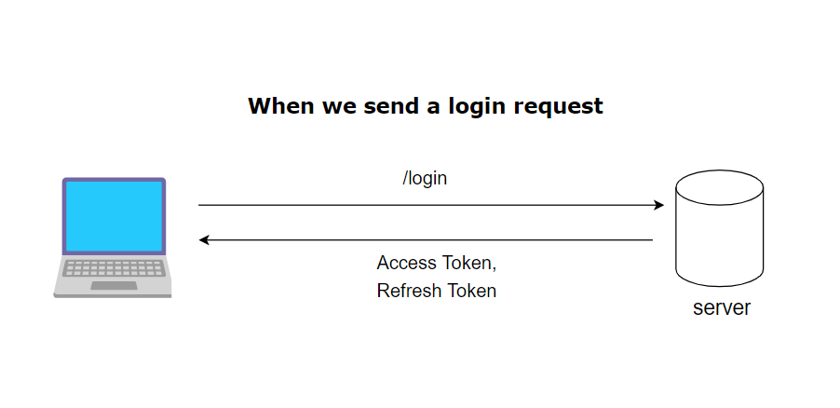

Slide 13
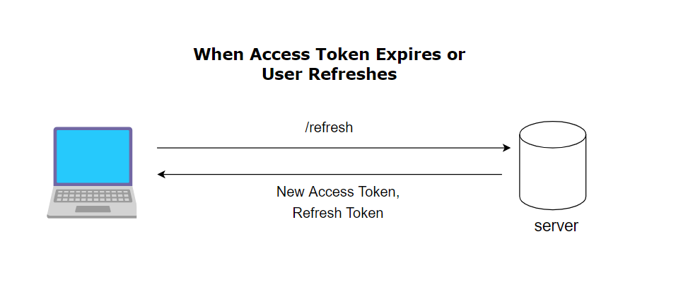
When it is created?
Example:
https://www.youtube.com/watch?v=HGIdAn2h8BA

